Slide 1
Learning Objective
To learn how to send your CRCA and ACC transcripts to a university.
Agenda:
1. Announcements
2. Slideshow

Slide 2
Upcoming Events
Thursday, October 1- Mandatory Virtual 12th Grade Parent Night 6-7 PM/ FAFSA is ONLINE
Saturday, October 3- SAT Test
Tuesday, October 6- Virtual FAFSA Workshop 6:00-8:00pm
Friday, October 9-Monday, October 12- BISD Holiday, ACC still has class on Monday

Slide 3
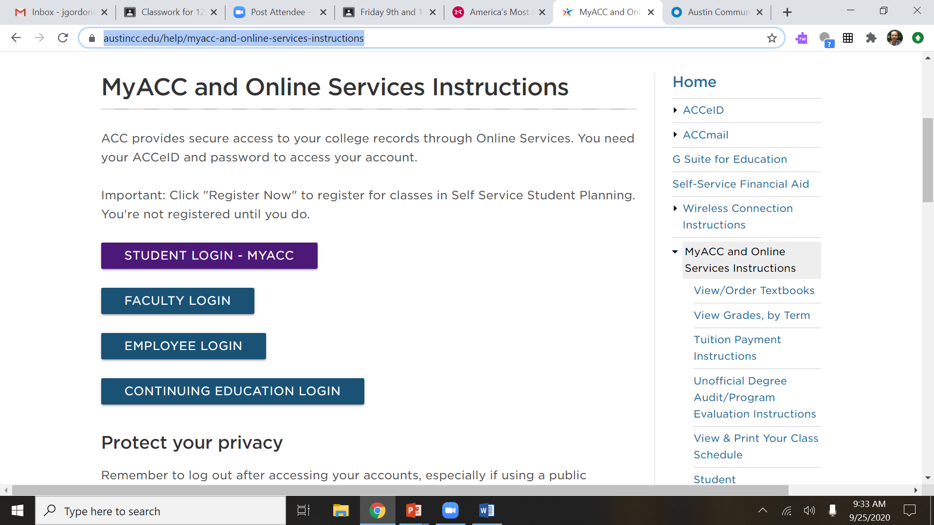
How Do I send my ACC transcripts?
Go to this website:
https://www.austincc.edu/help/myacc-and-online-services-instructions
And use the Student Login

Slide 4
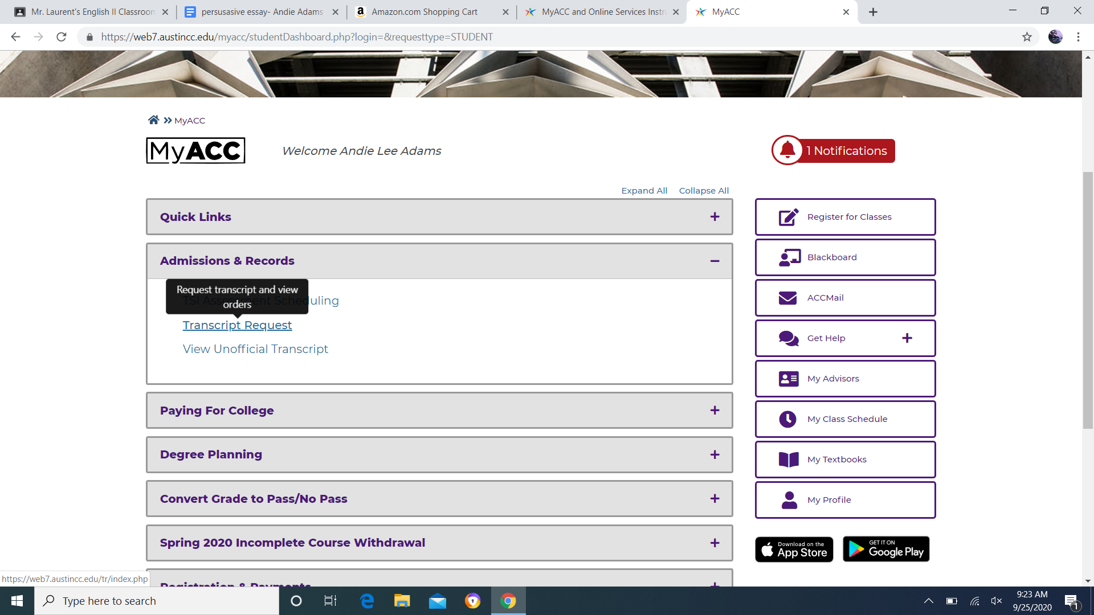
How Do I send my ACC transcripts?
After you Login you will choose Transcript Request from the drop down menu under Admissions & Records.

Slide 5
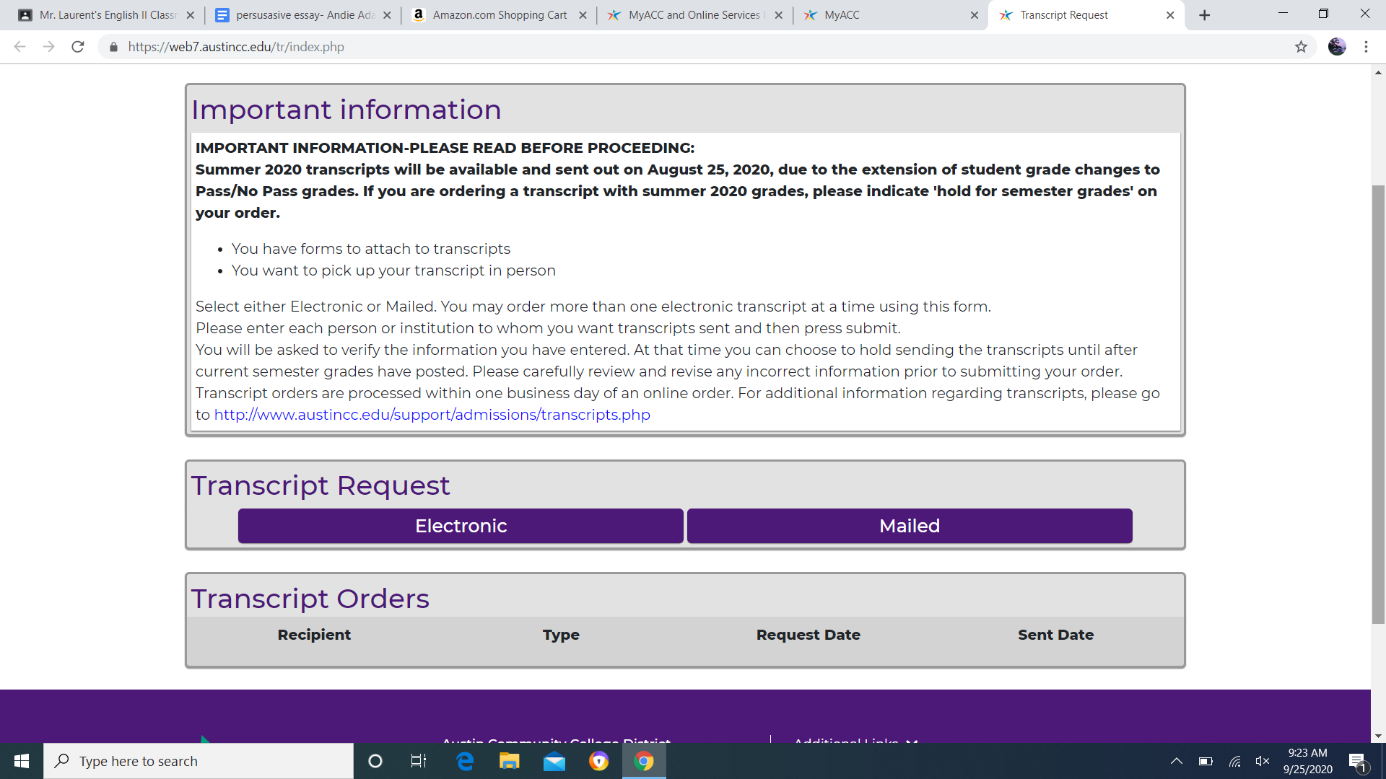
How Do I send my ACC transcripts?
Now you will choose to send it electronically or by mail. First click electronic to see if your college is listed. This will arrive within a few hours.
If your college is not listed, choose mailed. This will arrive in a few days.

Slide 6
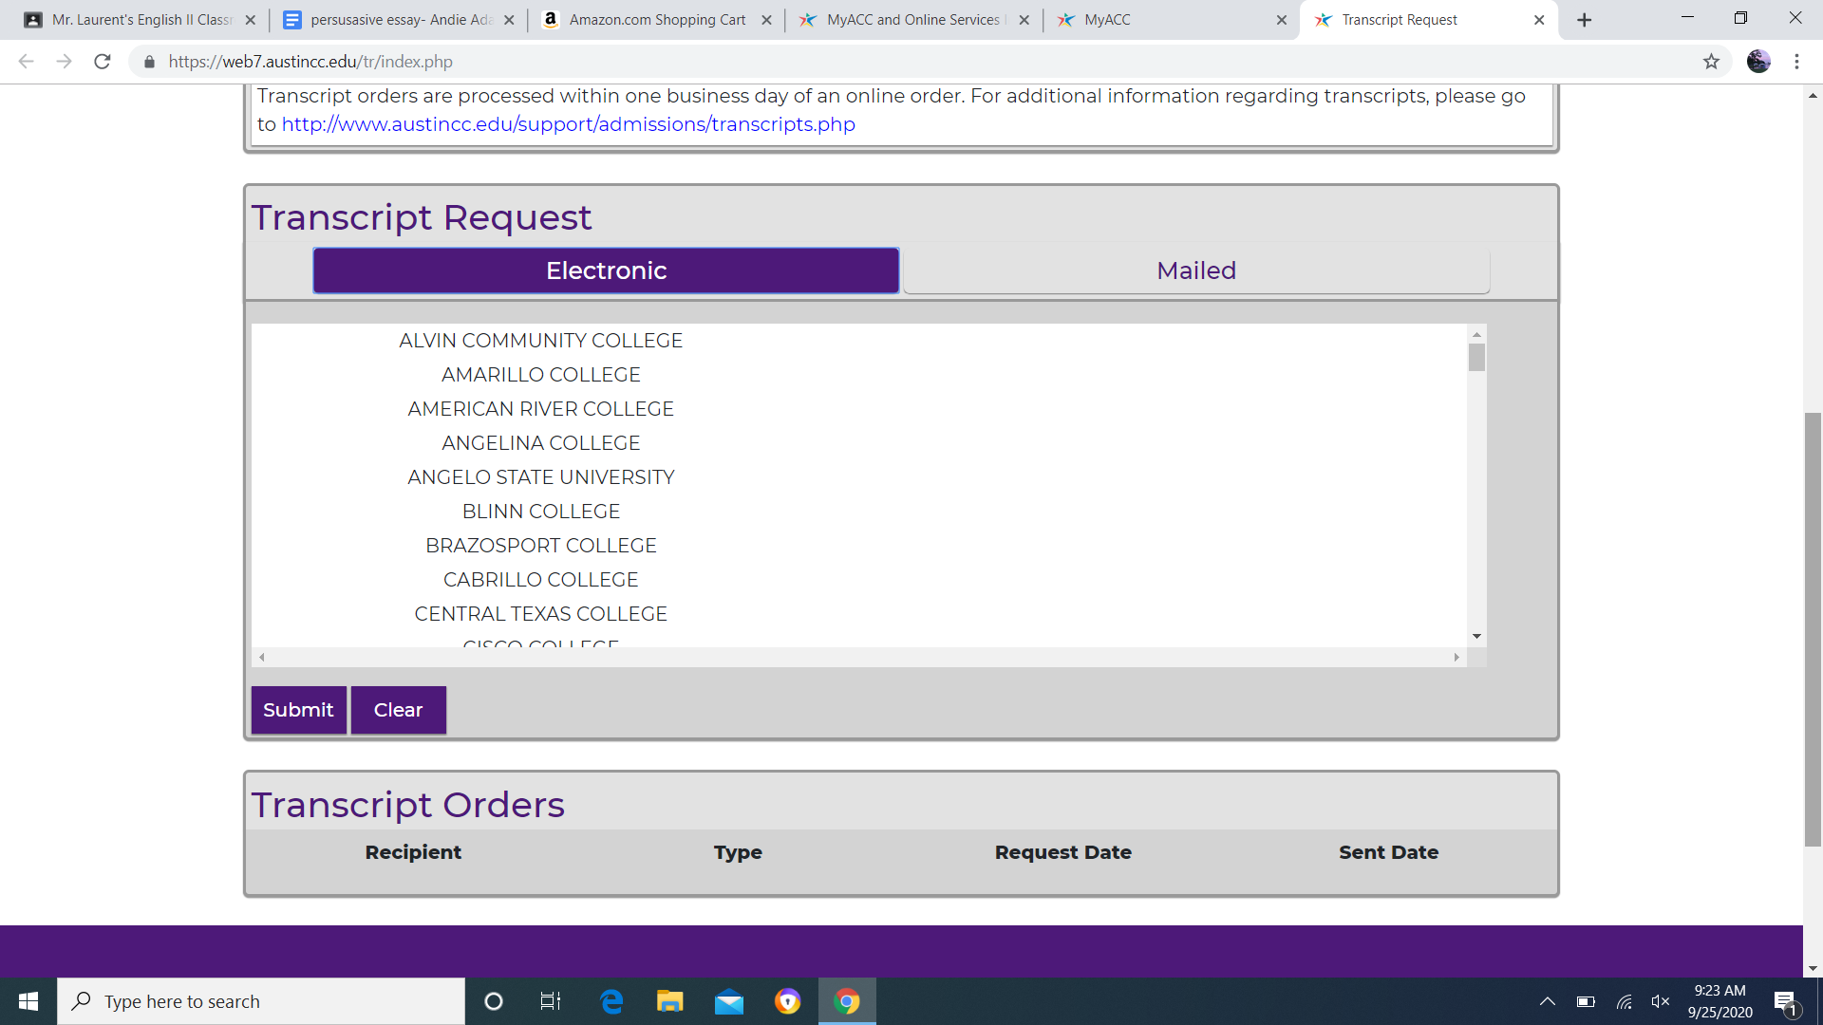
How Do I send my ACC transcripts?
If you choose electronic, here is the list of colleges. Most colleges in Texas are here.
Once you order your transcript, it will be listed here.

Slide 7
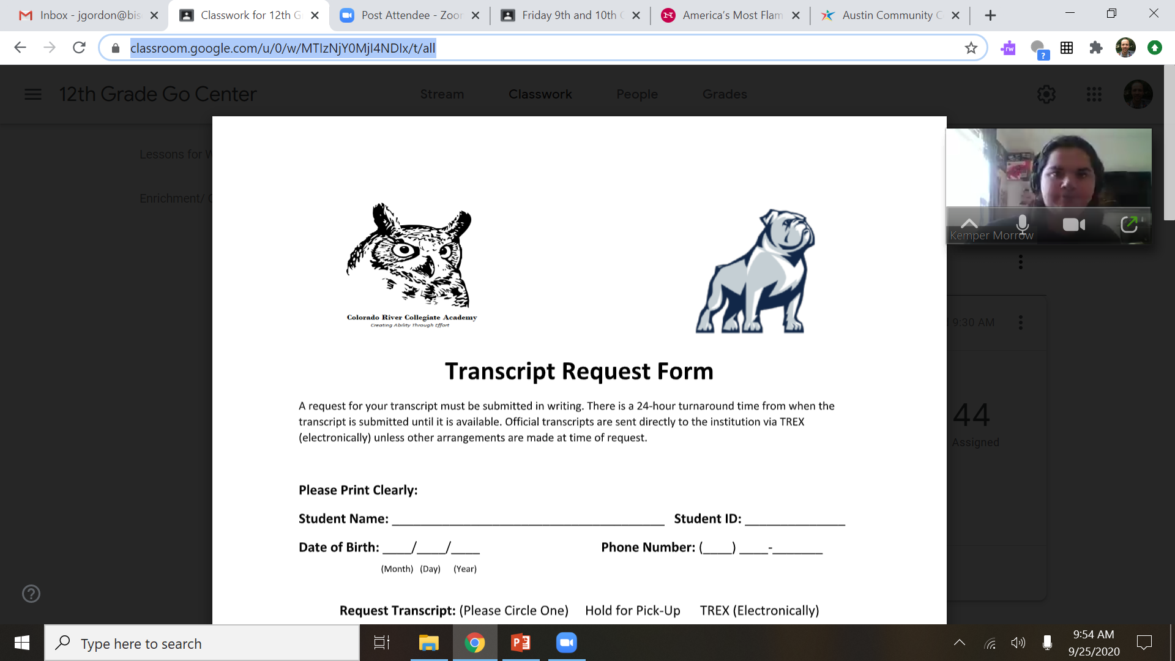
How Do I send my CRCA transcripts?
Go to:
https://classroom.google.com/u/0/w/MTIzNjY0MjI4NDIx/t/all

